Slide 1
RIDE SHARING APP FOR UMaT STUDENTS

Slide 2

Group Members
Abdallah Mustapha
Amponsah Ewurama A.
Apreko Elijah Nana Yaw

Slide 3
Problem Statement
1

Slide 4
Nana Esi, a UMaT student needs to go to town to run personal errands. This will cost a lot if she goes individually. Our app will help her carpool with other UMaT students who may have scheduled to go to town around the same time.

Slide 5

Why is car pooling important to Nana Esi?
She will be able to :
Save some of her money.
She would save time.
Make new friends.

Slide 6
OUR SOLUTION
2

Slide 7

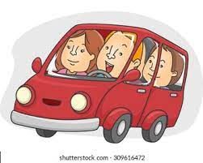
JoinMe
Helping UMaT students save money and make friends by car pooling through an app.

Slide 8
The process is easy-Peasy
Find/Share a ride
Get into the taxi !
Arrive at your Destination
Check for available rides to your destination or find people to share your ride with.
Make sure to be at the pick up point on time.
1
2
3

Slide 9
Information Gathering
3

Slide 10
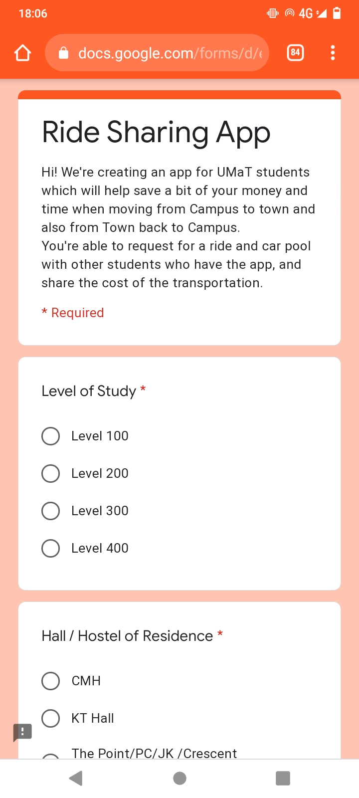
Survey
We collected responses from a number of UMaT students via google forms.

Slide 11
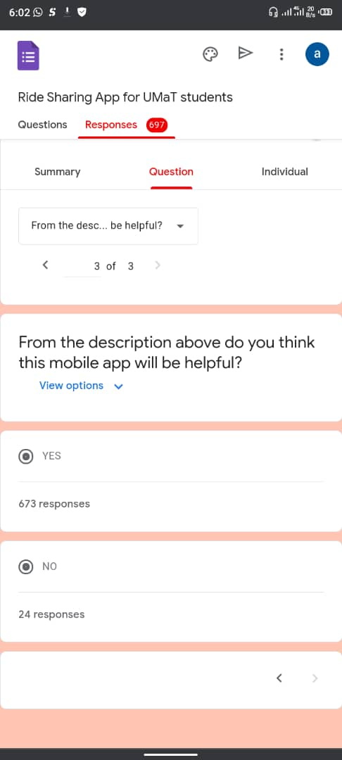
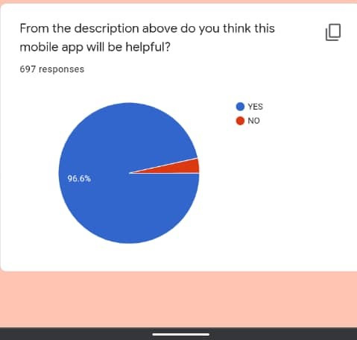
697
673
96.6%
Total responses
Yes responses
Total success!

Slide 12
FLOW CHART
4

Slide 13
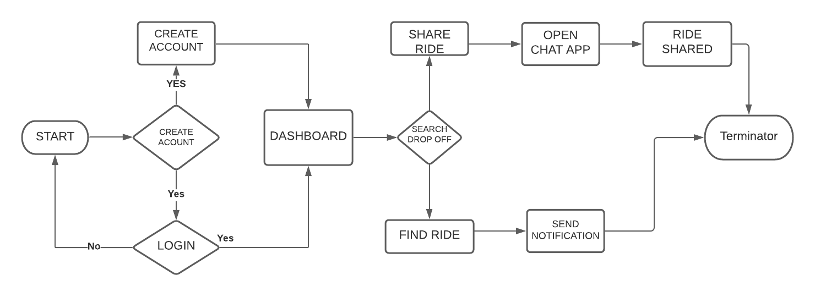
FLOW CHART

Slide 14
Designing the user interface
5

Slide 15

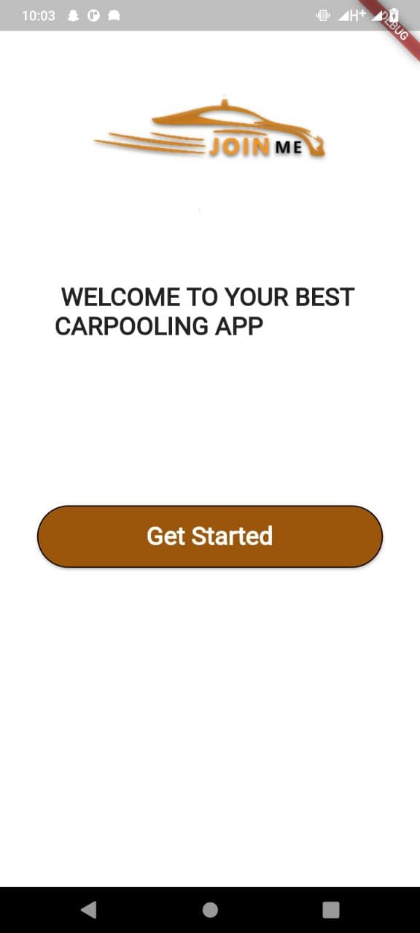
Landing Page
This is the landing page of our app.

Slide 16
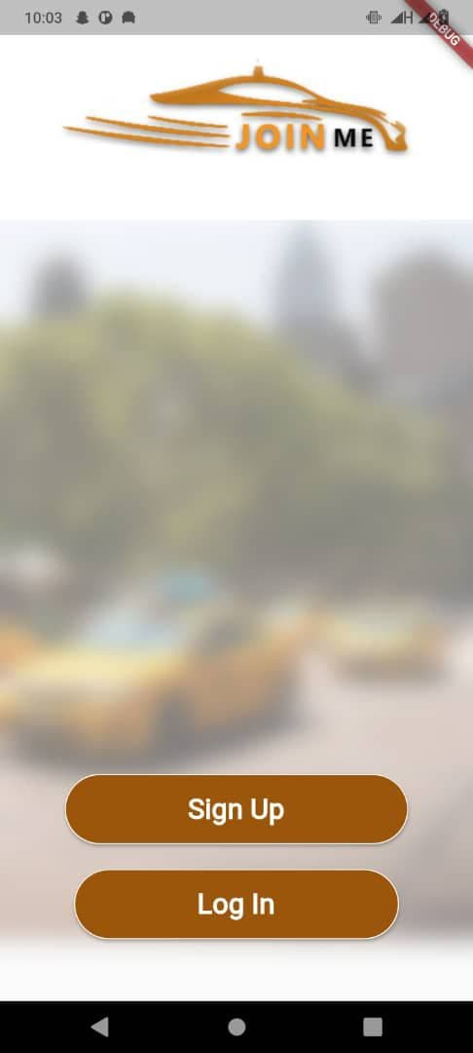
Getting started!
Here, the user has the option to log in or sig up.

Slide 17
Signing up as a user

Slide 18
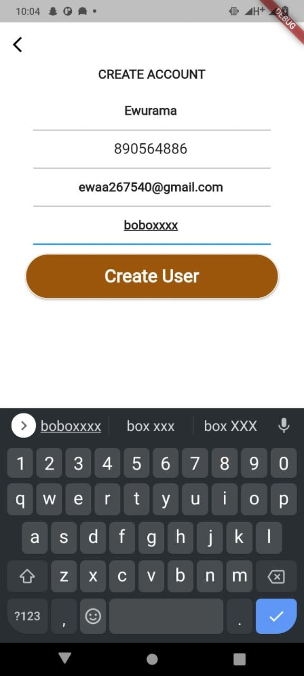
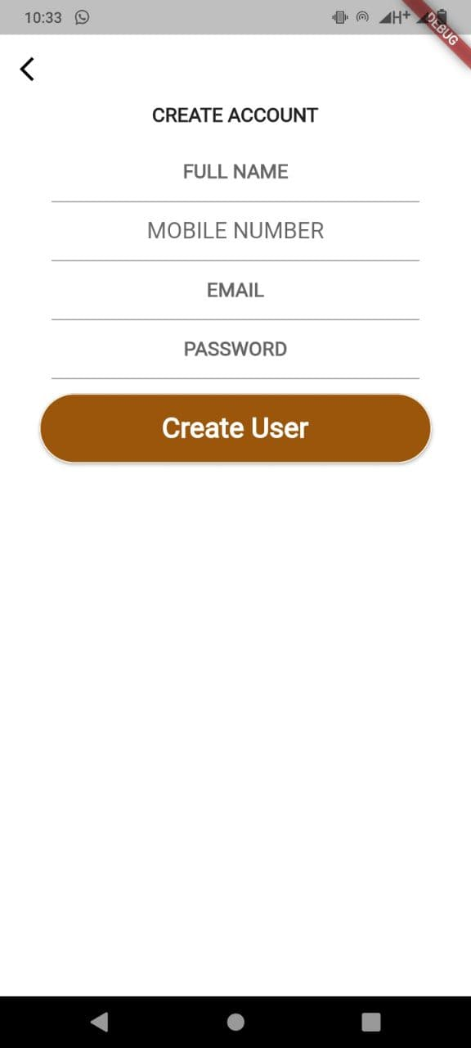
Let’s create an account!
The user is required to enter a few details.

Slide 19
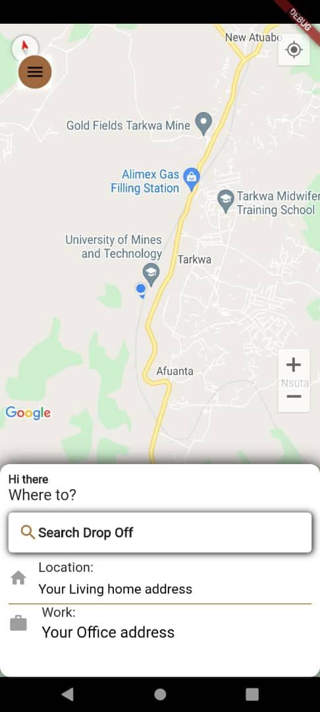
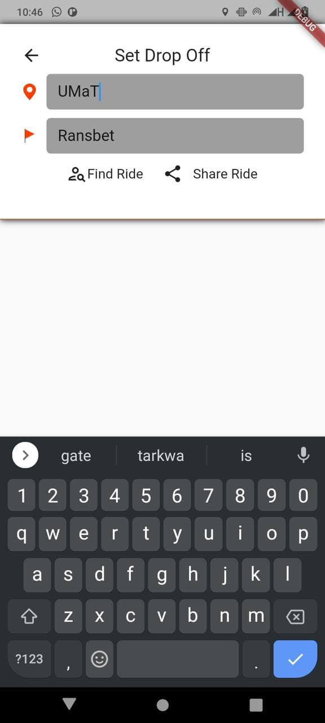
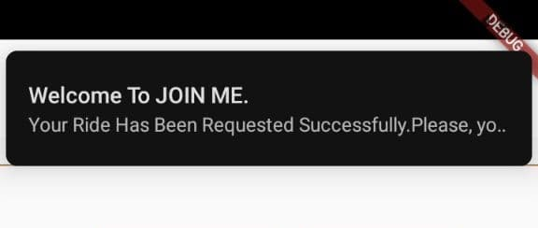
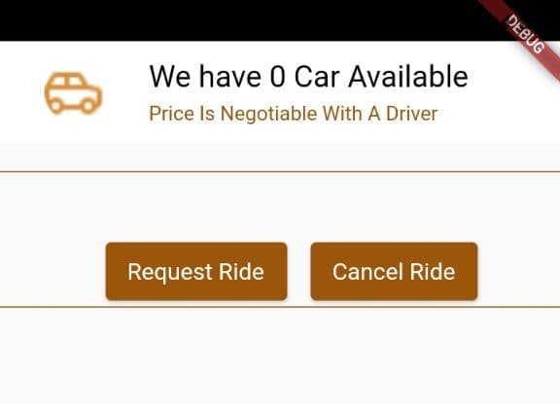
How to Get a ride?
Enter pickup and drop off locations
Notice of availability of ride.
Notification of confirming your requested ride will be sent to your phone

Slide 20
Signing up as a driver

Slide 21
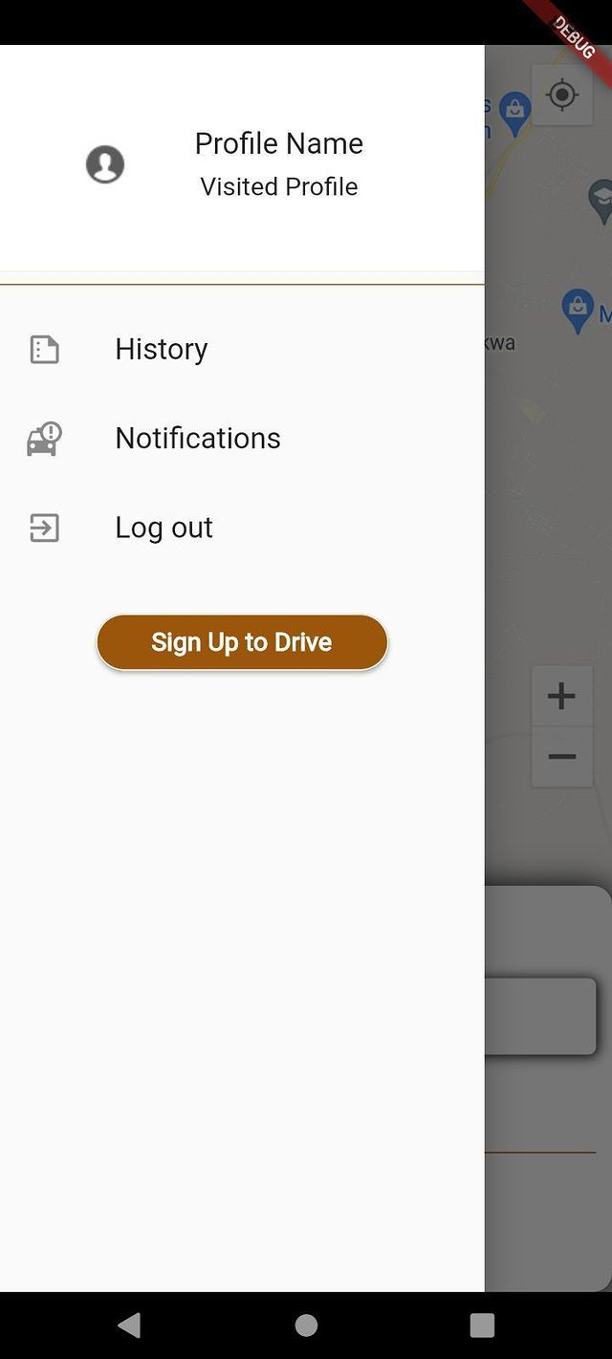
How ?
Click on the menu bar on the top left corner to reveal the side bar menu as seen.
Click on the Sign Up to Drive button

Slide 22
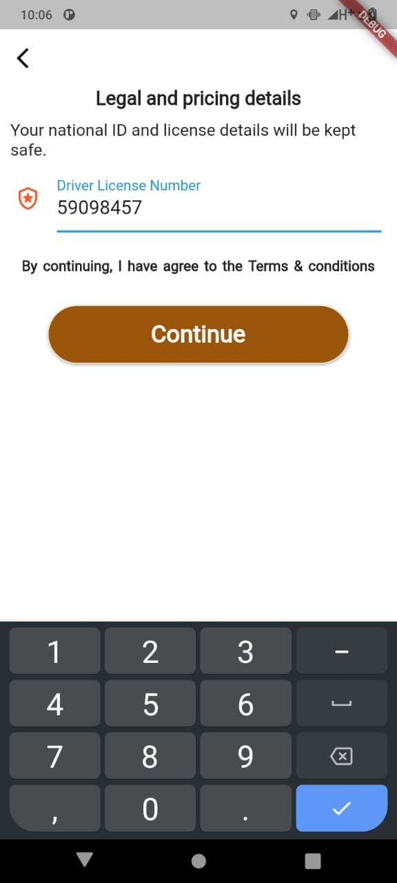
Enter details
Click on the Sign Up to Drive button

Slide 23
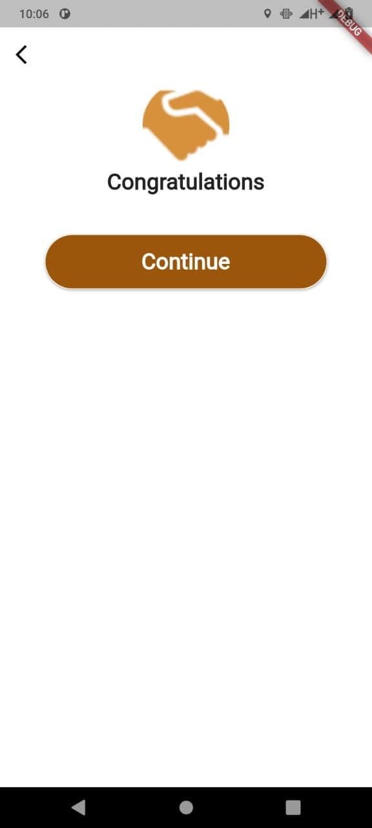
Voila!!

Slide 24
Back end functionalities
6

Slide 25
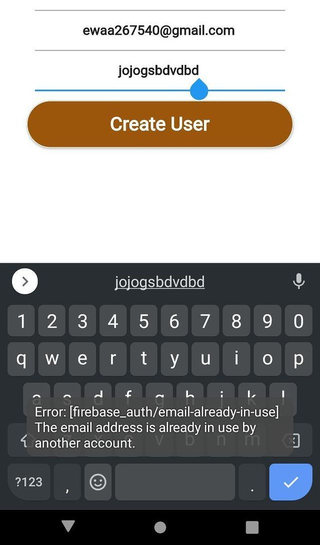
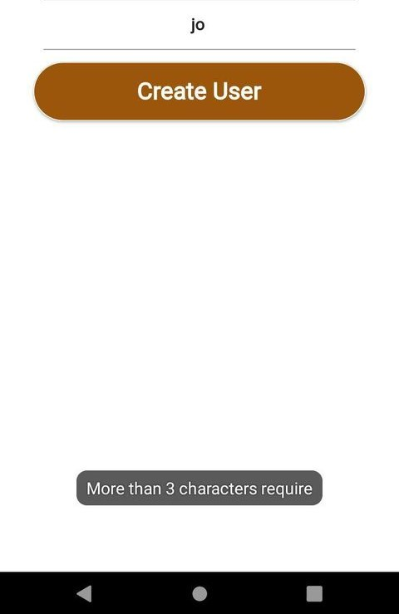
Email
One email cannot be used to create more than one account.
Password
A minimum of four characters is required for the password.

Slide 26
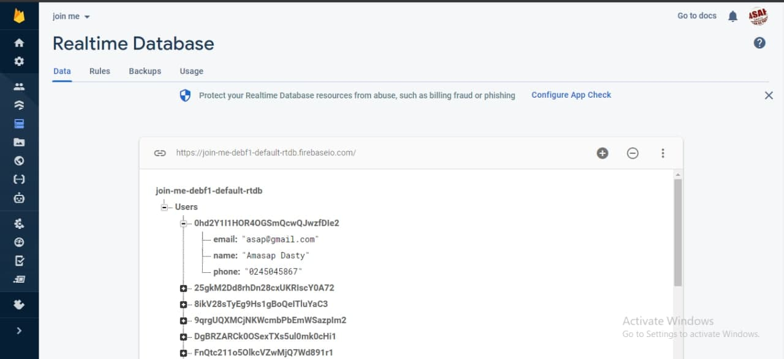
Record of users In our database so far…

Slide 28
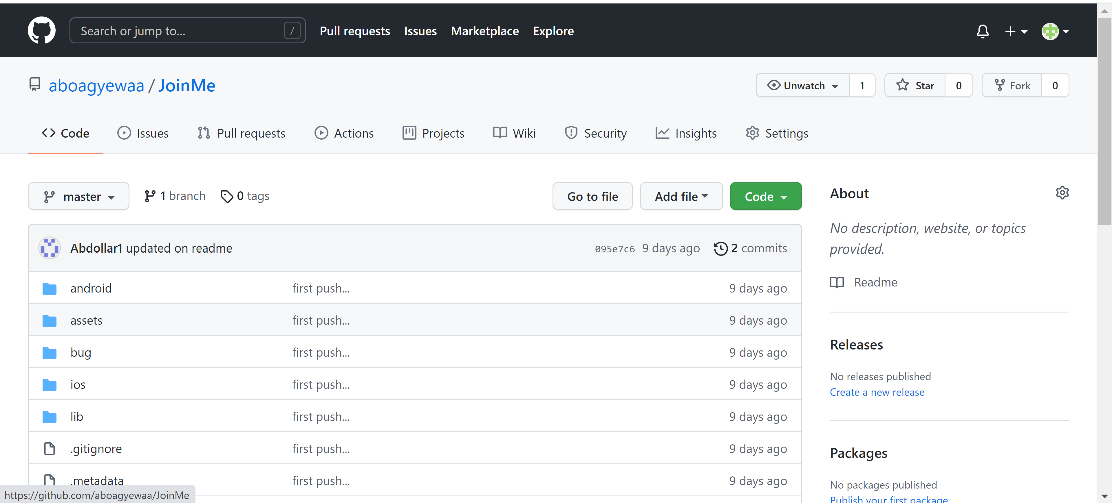
GITHUB REPO

Slide 29
References
Viewed 5 June,2021 <https://www.dreamstime.com/illustration/cartoon-taxi.html>

Slide 30
Thanks!
Any questions?

